Slide 1
Linear Programming
biological data science
spring 2019

Slide 2
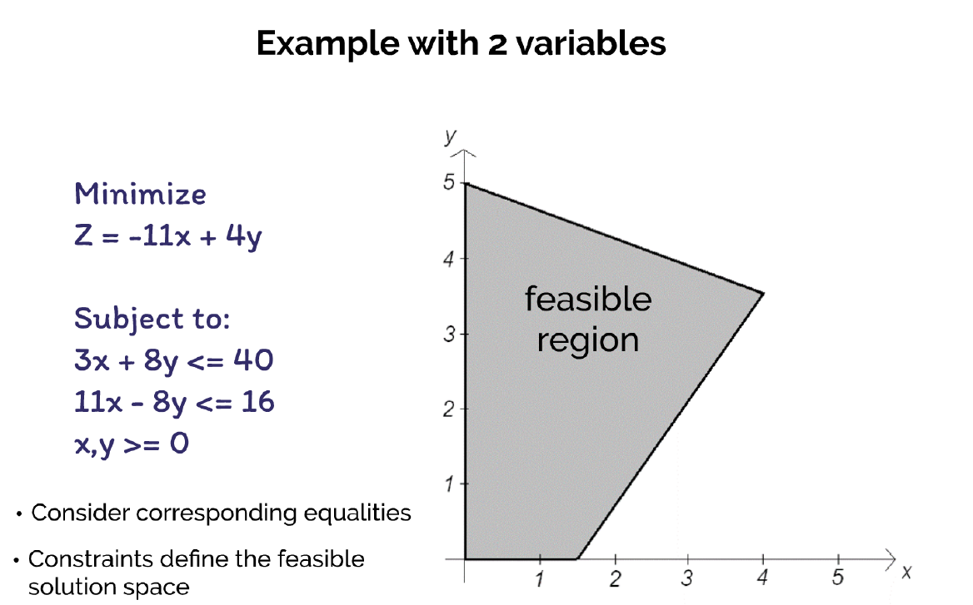
Integrality not required, so this is just a linear program (LP)
Relatively easy to solve

Slide 3
Solve using objective function line

Slide 5
Require integrality

Slide 6
MIPs
Mixed-Integer Linear Program (MIP)
Linear objective and constraints
One or more variables must be integral
Generally NP-hard

Slide 7
Increase number of variables
3 variables
Each constraint is a plane
All feasible integral solutions are contained within (or on) polytope
Objective function is also a plane
Many variables
High-dimensional space
Convex polytope
Defined by hyperplanes
Optimal solution where objective hyperplane intersects last integral solution

Slide 8
George Dantzig
Graduate student at Harvard in 1939
Late to class
Copied homework off board
“harder than usual”
Solved two famous unsolved problems in statistics!
Scene in Goodwill Hunting based on Dantzig

Slide 9
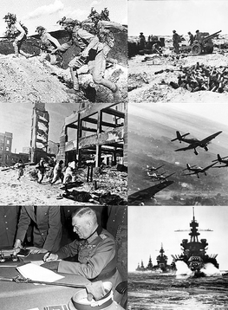
George Dantzig
Joined US Air Force during WWII
Colleague challenged him to mechanize planning processes
Invented Simplex method
‘Father of linear programming’
Great improvements
Logistics
Radar communications
Equipment procurement
Infrastructure
Sinking of submerged U-boats went from 1% to 7%
Average number of rounds to shoot down a plane
20,000 down to 4,000

Slide 10
Simplex Method
Common approach to solve LPs (no integrality)
Ranked as the 2nd most influential algorithm in the 20th century
Computing in Science and Engineering

Slide 11
Simplex Method
Optimal solution must be located on a corner of the polytope
Move along edges, always in direction that improves the solution
LP is transformed into “standard” form
Additional variables might be introduced
Exponential time in worst case
But usually very fast in practice

Slide 12
How to solve MIPs?
Several approaches
Exhaustive enumeration
Branch-and-bound
Cutting planes
Branch-and-cut
Cut-and-solve

Slide 13
Branch-and-Bound
Use a search tree to partition solution space
Branch for possible values of variables
Determine lower and upper bounds at each node
For a maximization problem
A lower bound is a feasible, though not necessarily optimal, solution
An upper bound is a limit on how high the optimal solution could possibly be
Use bounds to prune away subtrees

Slide 14
0-1 Knapsack Problem
A thief has a knapsack that can only hold W pounds
Objective is to determine which items to take in order to have the maximum value
How can we cast this as a MIP?

Slide 15
0-1 Knapsack Problem
What is an upper bound on the optimal solution?
We can relax the integrality constraints (LP):
Take as much of the most valuable items until knapsack if full
Item 1: $60 / 10 = $6 per pound
Item 2: $100 / 20 = $5 per pound
Item 3: $120 / 30 = $4 per pound
All of 1 + all of 2 + 2/3 of 3 = $240

Slide 16
Branch-and-Bound
For a maximization problem:
Find upper and lower bounds at the root node
Upper: Solve the LP version by relaxing integrality
Lower: Round down variable values (incumbent)
Branch variable with greatest fractional part
Create two new nodes to reflect the two possibilities
Solve LP relaxation at each node (upper bound)
If LP has integral solution
Prune subtree
Update incumbent if better
If LP is worse than incumbent or is infeasible
Prune subtree
Choose node with the greatest upper bound and repeat from Step 2 until tree is explored
For a minimization problem: relaxed solutions are rounded up, and upper and lower bounds are reversed

